Slide 1
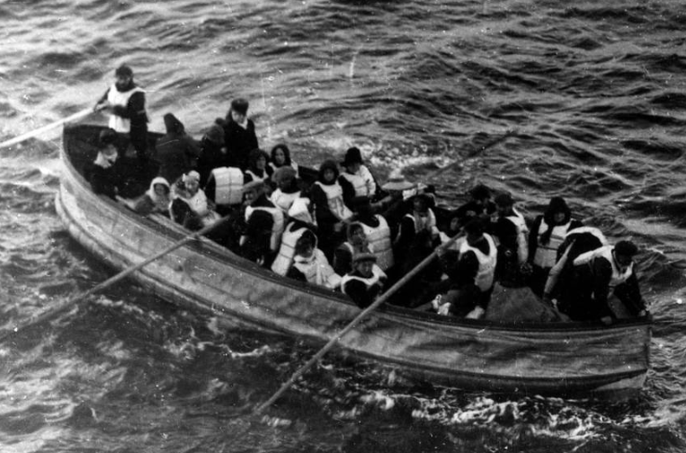
EDA - titanic survivors
Finding the factors that influenced
the survival rate

Slide 2
Exploratory Data Analysis steps
Insights from row data
Data insights and data cleaning
Data relationships
Summary / bonus: Comparison with the lab 3.2.1

Slide 3
Insights from row data – understanding our variables
In 1912, the Titanic sank killing 1502 out of 2224 passengers and crew
Our data as a csv file – we assume from a reliable source:
1309 passengers – 891 passengers recorded as survived/died
Variables available: passenger ID, Pclass, sex, age, sibling/spouse, parents of children, ticket number, fare, cabin, embarked (port)
Missing values in 4 columns: survived (418), age (263), cabin (1014), embarked/port (2)
Types of columns: 4 categorical columns: embarked, survived, sex, Pclass Ticket is a mix of numeric and alphanumeric data types. Cabin is alphanumeric. Numerical: AGE, FARE(continuous), SibSp, Parch(discrete.)

Slide 4
Data insight and data cleaning
Frequency Analysis of the categorical columns: embarked, survived, sex, Pclass
Survival rate is 38%
Creating a family column (simplifying the data)
Replacing missing values for age:
Based on the mean of the class
Simplifying class column with proper labels
and finding out 54% were travelling in 3rd class
65% of passengers were male
70% embarked from Southampton
Grouping age into bins: kids, youth, elders, senior
and finding out 60% of the passengers are under 30yo

Slide 5
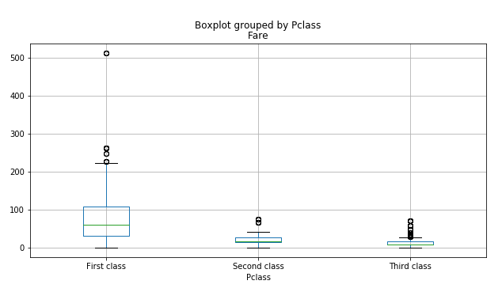
Data insight and data cleaning
Numerical vs Categorical
Box plot to see sex vs age (fairly similar around 29 but many outliers)
then class vs age (39yo for 1st then 10 years less for 2nd & 5year less for 3rd)
Boxplot class vs fare ($87 1st class, $21 2nd class, $13, 3rd class)
boxplot age vs fare (less diff) -> Fare is more dependent on the class than the age

Slide 6
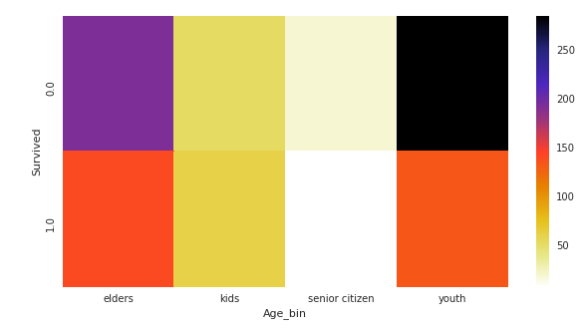
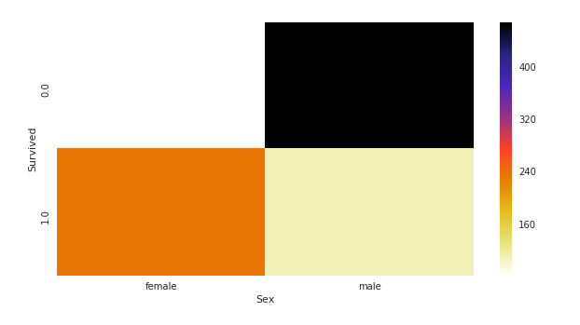
Data correlation
Numerical vs Numerical
Correlation doesn’t exist between age and fare
Categorical vs categorical
Survival rate is high in females (74%) and very low in males (19%)
Survival rate is highest in kids and least in senior citizens.

Slide 7
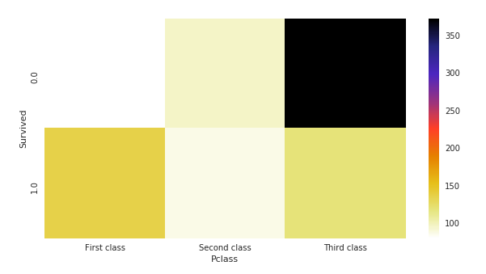
Data correlation
First class people has the highest survival rate
Heat maps are a great way to take all the data into account in one simple graph as it’s tricky to visualise the number of people in each class + the ones who survived or not (2 graphs)

Slide 8
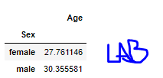
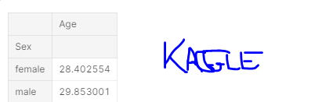
Summary and EDA from Kaggle vs lab 3.2.1
Different approach to lab 3.2.1
Different and simpler data cleaning in kaggle
Age was based on mean from sex in lab here it’s based on mean from class
Cabin was based on mean from class and didn’t get replaced or used here
Embarked was based on most prominent value for lab and didn’t get used here
We also created a family column in Kaggle which wasn’t used
-> It is useful to think about what we want to know before cleaning all the data

Slide 9
Summary and EDA from Kaggle vs lab 3.2.1
Different way to analyse correlations
Lab:
Simple bar charts to analyse data and logical structure
Looked at class (1st class = higher chance), sex (female = higher chance), parch and sibsp (alone lower chance), port (not much insight), fare (higher = higher chance)
The bar charts were good too but perhaps harder to interpret at a glance when there were 2 in one graph
The stat overview/correlation in lab was hard for me to interpret
Kaggle
Used num vs categorical analysis and I am not exactly sure why, structure is hard to understand
Looked at age vs fare (no correlation), sex (female = higher chance), age (kids = higher chance), class (1st class = higher chance)
Used boxplots (perhaps unnecessarily?) and heat maps to visualise results
Bok plots are good for simple/initial analysis and heat maps are a great way to take all the data into account in one simple graph

Slide 10
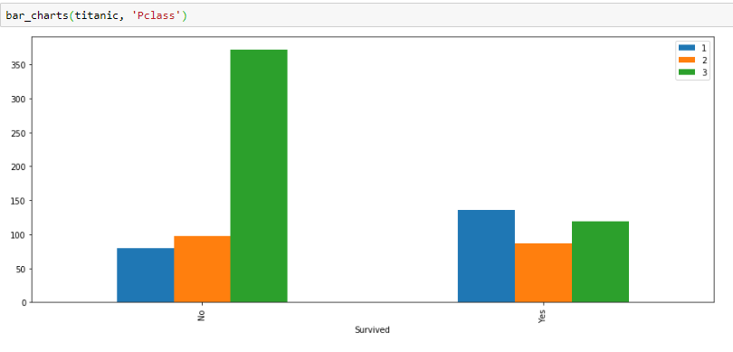
Summary
Heat maps can be a powerful way to display all the data in one simple graph instead of using two charts, although it’s perhaps less precise

